Slide 1
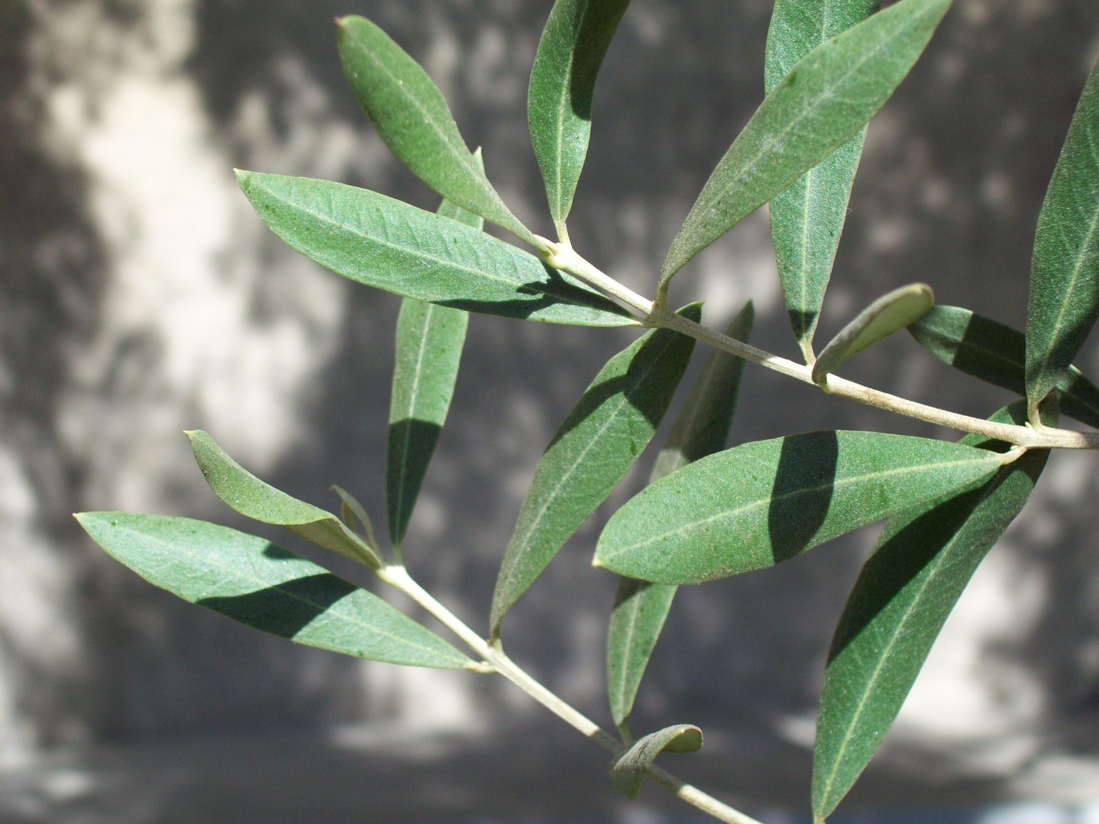
Energy & Climate Action
John Onderdonk
Manager for Sustainability Programs
Matthew Berbee
Energy & LEED Manager
June 11, 2010

Slide 2
Overview
Energy
Conservation Initiatives & Projects
Alternative Energy
Climate Action
Emission Sources
Mitigation Projects

Slide 3
Relevance to Caltech
Enhancing Caltech’s core mission of research and education by:
reducing Caltech’s environmental impact
promoting stewardship within the Caltech community
Notes:
Why important to Caltech?
GREEN for GREEN sake does not make sense,
But where we reduce our env impact and promote community stewardship it makes sense
Host of other reasons this is important
From money to
Attracting talent to
Branding
To comparison
to swirling regulation and eventual carbon markets

Slide 4
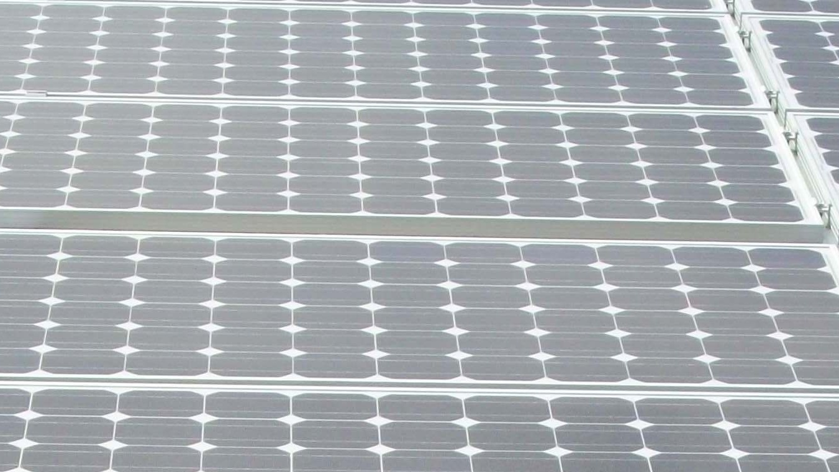
Energy

Slide 5
Electricity Consumption by Source
Notes:
Rise 7% for several years
Level last 3 years. Rise in use offset by cooler temps
06 ot 07 CCD down by 5%
06 to 08 CDD down by 7%
4M maintained sq. ft.
60 core buildings
CIT: 283,611 BTU/sqft (22MW peak electrical demand)
JPL: 192,278 BTU/sqft (18.5MW peak electrical demand)
$20M gas/electricity budget

Slide 6
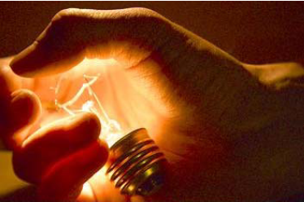
Demand Side Management
Actions that influence the quantity or patterns of energy use.

Slide 7
Retro-Commissioning (RCx)
Retro-Commissioning
A process to optimize building system performance
Benefits of Retro-Commissioning
Typical annual energy savings: 5% - 10%
Fewer occupant complaints/issues
Improved Indoor Air Quality and working environment
Currently underway in 30 buildings representing 50% of the campus building square footage
Notes:
RcX Potential
3.76 Million gross square feet of maintained CIT space
Typical dollar savings from RcX is $0.42 / SQFT ($.11/SQFT to $.72/SQFT - Range)
After Initial 5 year cycle +/- $1,579,200 potential savings
per year from RcX
Plan to RcX all buildings every 5 years

Slide 8
Retro-Commissioning Plan
Fume Hood Optimization
Chilled and Hot water valves
Building Sequence of Operation Optimization
Scheduling Adjustments
Coil cleaning
Duct leakage repair
High Efficiency fans
Wireless thermostats
CO2 monitoring to reduce excess ventilation
Lighting Upgrades
2009 - 2010
2010 - 2011
2011 - 2012
Notes:
Cost avoidance of $400K in first year
Carbon reduction of 1,370 MT CO₂e per year

Slide 9
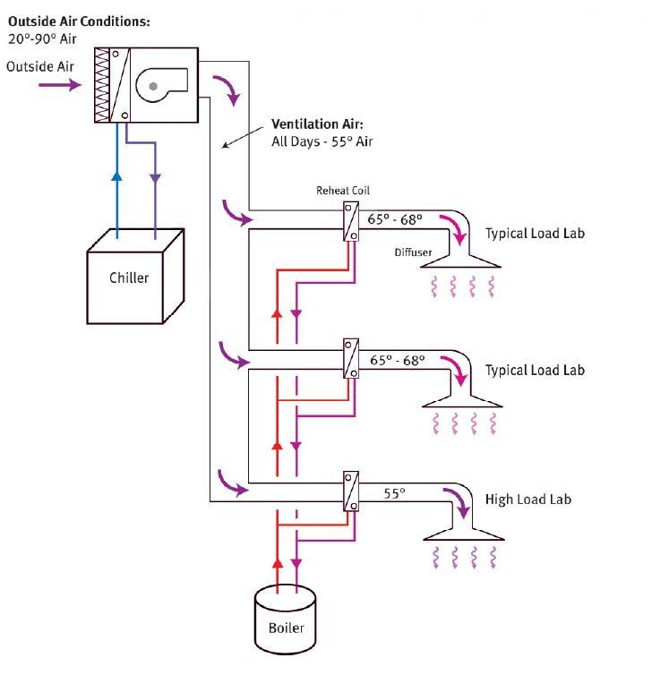
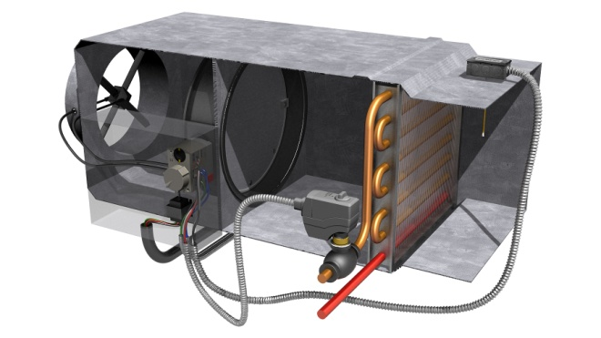
VAV (Variable Air Volume) HVAC Systems
Standard Lab VAV Reheat System
Supply Air Must be cooled to satisfy Highest Heat Load – Re-Heat is incorporated through re-heat coil in VAV box to warm supply air to appropriate zone demand.
Possible Points of Failure – Typical VAV
Over time the identified points below are subject to failure resulting in system inefficiencies and/or occupant dissatisfaction.
Temperature Reading Calibration
Air Flow Reading Calibration
Frozen Damper
Typical VAV
Damper Motor Failure
“Typical annual energy savings from RcX range from $0.11 - $0.72 / sqft”
A Retro-commissioning guide for building owners, EPA
Hot Water Valve Failure

Slide 10
RCx Findings – HVAC Running Weekends
Air-Handler running during scheduled Unoccupied Time
Notes:
Tie discussion to AC-Runtimes and the potential benefit of enforcing a reduced allowed after-hours schedule.

Slide 11
RCx Findings
Air-Handler – Excessive Cooling
Valve Command (% Open)
AHU chilled water valve should not be open with Outside Air TEMP less than 55 DEG F
Outside Air Temp (OAT) (Deg F)

Slide 12
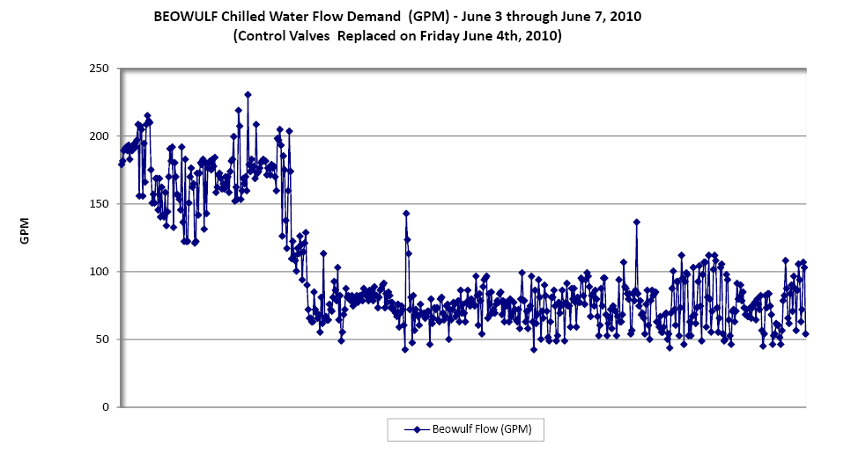
BEOWULF HVAC Upgrade
Benefits of Hot/Cold Aisle realized after CRAC Unit chilled water valves were replaced
PUE from 2.2 → 1.6

Slide 13
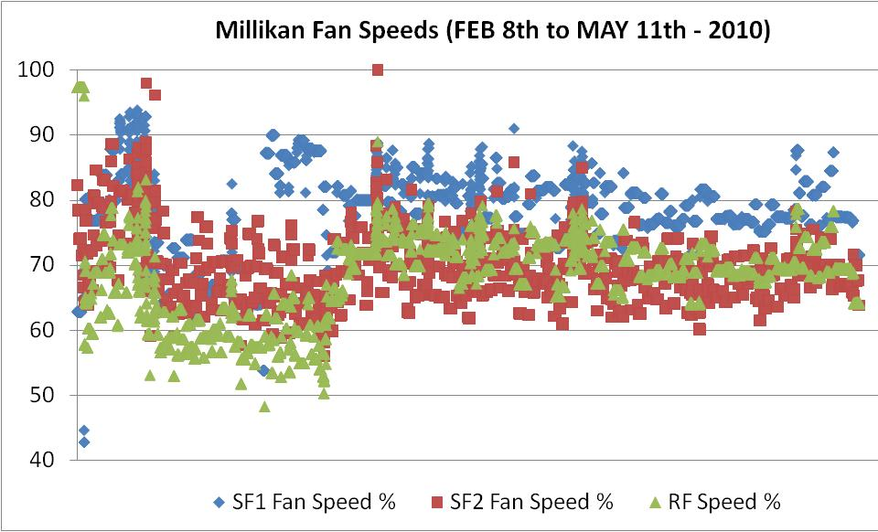
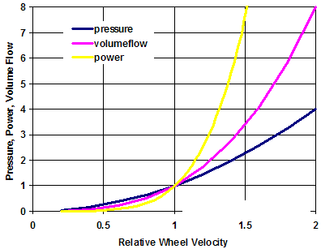
Verification of Performance
All Millikan fans were at 100% Speed all the time prior to the energy project
FAN Law 1c:
Power is proportional to the cube of shaft speed
331,400 Annual kWH Savings from VFD operation
10% Speed reduction is approximately a 30% power reduction, the cube root effect

Slide 14
Energy Conservation Economics
Caltech Energy Conservation Investment Program (CECIP)
Limited to 6 yr payback or better
Verified by Caltech Energy Manager and 3rd party consultant from PWP
$
Utility Savings
$
CECIP Funding Model
Implement Project with Energy Payback
$
Capital Revolving Fund
In two program years:
$1M+ rebates & Incentives from PWP
$1M+ annual avoided utility costs
Notes:
13

Slide 15
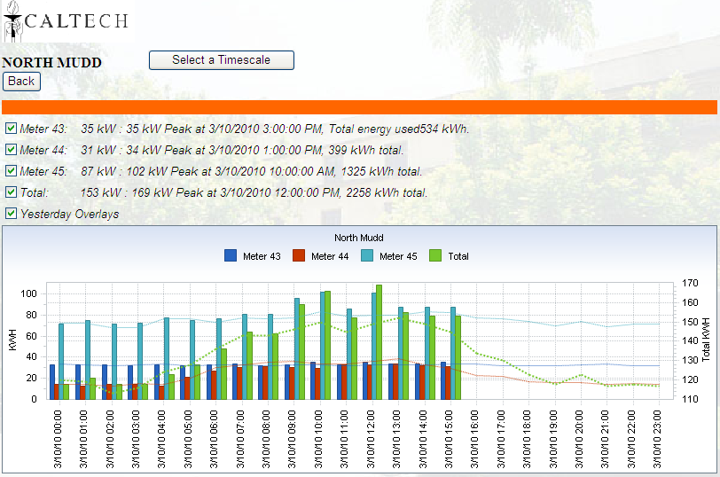
Caltech Enterprise Energy Management
GIS base map
Building automation data
Power monitoring and reporting
Demand side management
Automated utility billing
Caltech Interface Screen-Shot
http://sustainability.caltech.edu/energy
14
Notes:
14
Implementation: $80K (1 time fee)
Annual Hosting Fee: $60K Annually

Slide 16
Supply Side
Caltech is its own micro-grid with a diverse portfolio of energy generators.
The portfolio supports the energy needs of Caltech while being less carbon intensive than traditional purchased electrical power

Slide 17
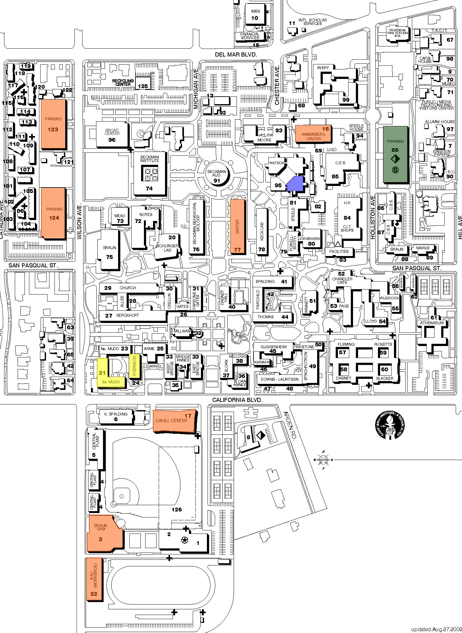
Caltech Solar Photovoltaic
Annenberg Center
64 kW
N. Wilson Parking Structure
342 kW
Holliston Parking Structure
200 kW
S. Wilson Parking
Structure
423 kW
Watson Laboratory
15 kW
Linde + Robinson Laboratory
25 kW
Baxter Hall
131 kW
South Mudd Laboratory
50 kW
Cahill Center
40 kW
Projects
Braun Gym
94 kW
Solar I
Caltech Student Solar Initiative
IPAC Laboratory
47 kW
Solar II
Linde + Robinson Lab

Slide 18
Fuel Cells – 20 Units – 2 MW
10 year contract
Power Purchase Agreement
No Caltech investment except enabling costs
No AQMD permit
No heat recovery
Install Fall 2010
Typical 100 KW unit
Notes:
Avoided cost is 0.18 per KWh
$0.138/kWh
5% annual escalation

Slide 19
Caltech Sources of Electricity Cleaner and more predictable costs
Source | Cost¹ ($/kWh) | Escalation | Percent of Consumption |  | Carbon Content (MTCE/GWh) FY 11
 |  |  | FY 09 116 GWh | FY 11 127 GWh
Pasadena Water and Power | .18 | Unknown; Politically sensitive; Best guess 5-10% | 38% | 22% | 700 - 800
Cogeneration | 0.05 - 0.06² | Depends on price of gas | 62% | 63% | 600
Solar 1 | .104 | 3.9% fixed for 15 years | <0.5% | 2% | 0
Solar II | .105 | 3.5% fixed for 20 years | 0% |  | 0
Fuel Cell 2 MW | .138 | 5% fixed for 10 years | 0% | 13% | 350
¹ Includes cost of capital and fuel
² @ $7 - $9 NYMEX; Burner tip is NYMEX plus ~$1.25
Notes:
NYMEX Cogen cost
$ $/kwh
6.5 .050
7 .0531
7.5 .0556
8 .0581
8.5 .0605
. 063
COGEN 0.086 lbs/MWh NOx 0.0149 lbs/MWh SOx
BE FUEL CELL Each 100kW system produces <0.7 lbs/MWhr of NOx and a negligible amount of SOx. (just at initial start-up).
FY09 Gen 72 GWh Buy 44 GWh Solar is 0.3 GWh for FY09
FY11 Gen is 80GWH
Solar I for 12 mo is 321 MWh
Solar II for 12 mo is 2030 MWh or
Together they are 2 %
Bloom is 26 GWh per year or 20 % of total in FY11
Jan ’10” Bloom is now 17 GWH or 13% of total for FY 11

Slide 20
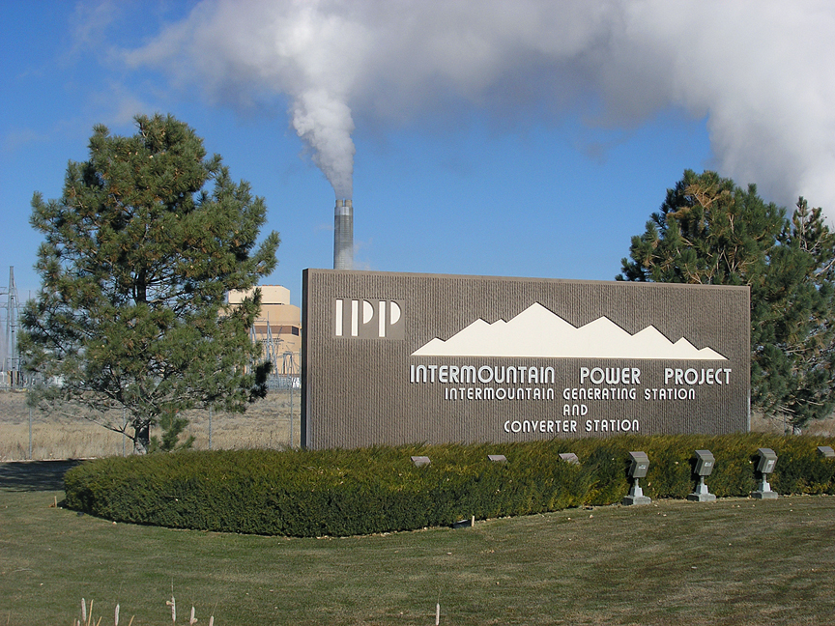
Climate Action

Slide 21
2008 Emissions Sources (MTCO₂e)
Student Commuting 1%
Other (water, solid waste, fleet vehicles, refrigerants) 2%
Air Travel 6%
Faculty & Staff Commuting 6%
On-campus Stationary 9%
Purchased Electricity 38%
Co-gen Electricity 11%
Co-gen Steam 27%

Slide 22
Projected Emissions & Reduction Goal
114,000 MTCO₂e
51,000 MTCO₂e
Reduction
92,000 MTCO₂e
63,000 MTCO₂e
63,000 MTCO₂e
Notes:
BAU: assumed 1% pop growth and 3 new blds by 2020
Consistent PWP mix of coal
2008: 95,000 from today 32,000 tons

Slide 23
Reduction Projects – Focus Areas
Increase building & facility energy efficiency
Retro-commissioning
Optimize energy performance in new construction & major renovations
Laboratories, high performance computing centers
Establish a conservation ethic within community
Elevated to a high priority through staff trainings
Real-time building energy dashboard
Energy Star procurement standard
Reduce the carbon intensity of the power supply
On-campus solar installations, fuel cell installations
Influence city of Pasadena
Purchase remote green power
Promote less carbon intensive transportation alternatives
Commuter incentive programs
Fuel efficient vehicles: fleet, commuter subsidies
Virtual meeting technology

Slide 24
Reduction Projects – Summary
Project Category | Annual MTCO₂e Reduction | Annualized Return per MTCO₂e Avoided
Completed, Ongoing, Probable Projects | 14,000 | $130
Anticipated or Possible Projects | 42,000 | $140
Potential Additional Projects and Activities | 5,900 | TBD
Offset Projects | 75,000 | ($70)

Slide 25
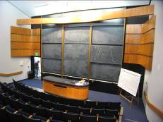
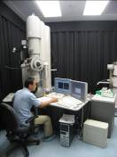
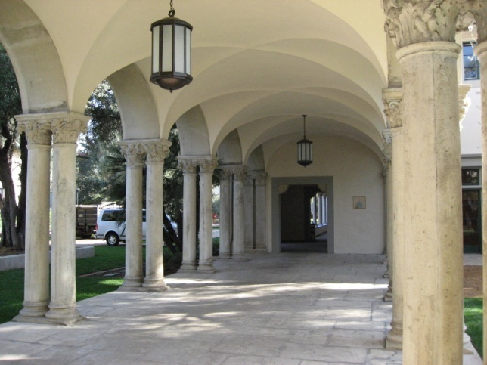
Questions? www.sustainability.caltech.edu

